Slide 1

Branded PowerPoint Template
December, 2021

Slide 2
Connecticut Children’s
PowerPoint Template Best Practices
This template has been developed to make presentation creation simple and consistent across the organization.
Each slide incorporates details about the layout as well as guidelines that will help in maintaining a consistent look and feel.
Text Sizing: Do not allow content to exceed space provided. Content should not extend above the green line/header or below the blue line/footer.
Colors: Do not change colors of typography. Only incorporate colors labeled “theme colors” in graphs and charts.
Fonts: Only use our brand font “Arial” as the font for all text. Do not change font size. Default font size is 18pt, but should not be smaller than 16pt for paragraph copy.
Photos: Please use the most up to date approved images located here.
http://intranet.connecticutchildrens.org/brand-shop

Slide 3
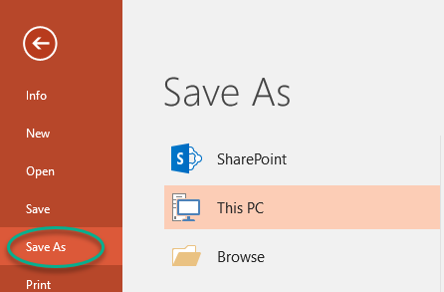
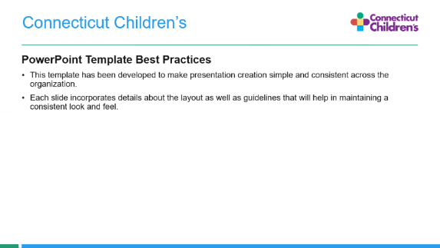
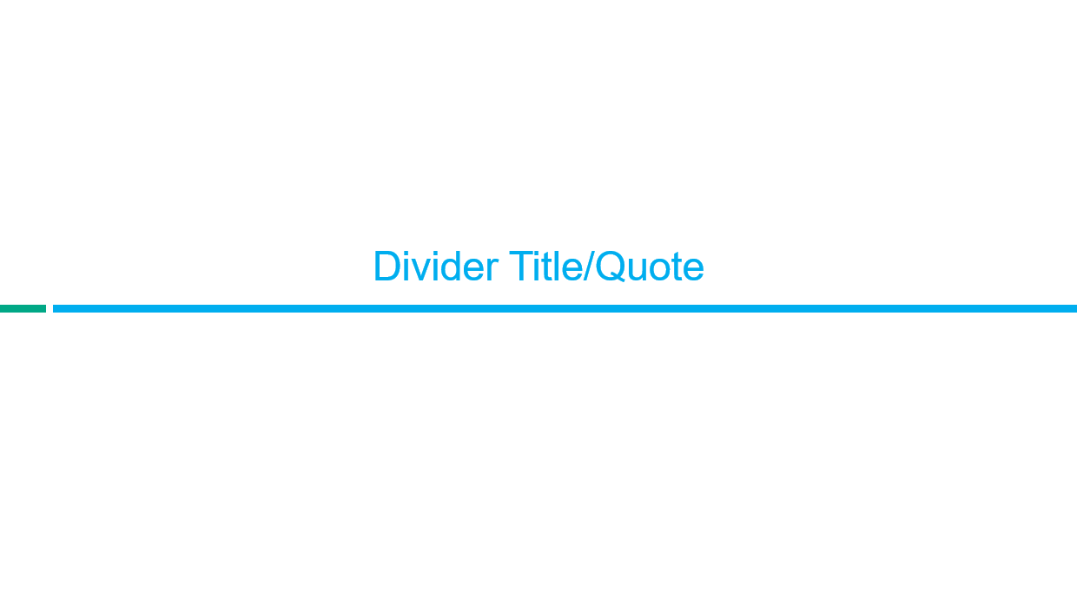
PowerPoint Best Practices
Always “Save As”
Simplicity
Organization
In order to maintain this document as a template, always “Save As” when creating a new presentation.
Keep content simple and concise, including keeping headlines to two lines. There is limited space, so if more content is needed, create another page.
Use divider slides to organize the flow of your presentation or to call out quotes or words of importance.
http://intranet.connecticutchildrens.org/brand-shop

Slide 4

PowerPoint Best Practices
Save this theme as your default template:
Go to the Design tab
Expand the Themes Gallery
Select the Save Current Theme command
Name the Theme file “2019 CT Childrens” & click Save
In the Themes Gallery, right-click your thumbnail & select Set as Default Theme
Note: You will need to repeat these steps if Information Solutions updates the Shared template on the server in the future.
http://intranet.connecticutchildrens.org/brand-shop

Slide 5

Presentation Title
Presentation Subtitle

Slide 6
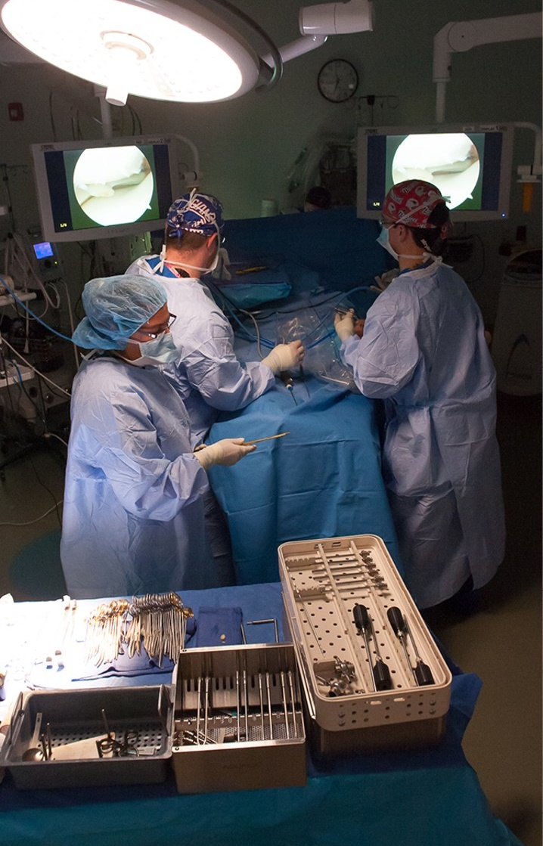
Presentation Title
Presentation Subtitle

Slide 7
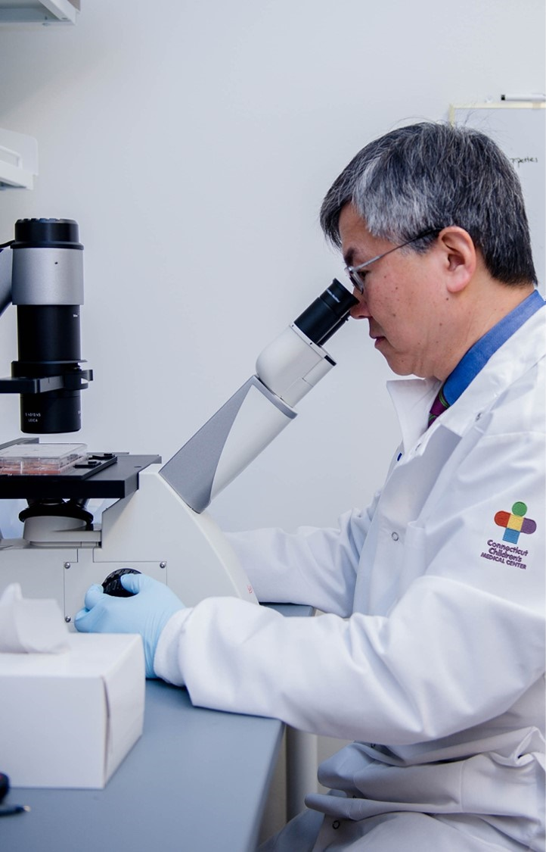
Presentation Title
Presentation Subtitle

Slide 8
Primary Icons
http://intranet.connecticutchildrens.org/brand-shop

Slide 9
Secondary Icons
http://intranet.connecticutchildrens.org/brand-shop

Slide 10
Divider Title/Quote

Slide 11
Table of Contents
Section 1
Section 1A
Section 2
Section 3

Slide 12
Your Slide Title Here
Paragraph Header Text
Indent once for paragraph body copy
Indent 2 times for bulleted text
Indent 3 times for secondary bulleted text
Indent 4 times for tertiary bulleted text

Slide 13

Your Slide Title Here
Paragraph Header
Indent once for paragraph body copy
Indent 2 times for bulleted text
Indent 3 times for secondary bulleted text
Indent 4 times for tertiary bulleted text

Slide 14
Your Slide Title Here
Paragraph Text
Indent once for paragraph body copy
Indent 2 times for bulleted text
Indent 3 times for secondary bulleted text
Indent 4 times for tertiary bulleted text
Paragraph Text
Indent once for paragraph body copy
Indent 2 times for bulleted text
Indent 3 times for secondary bulleted text
Indent 4 times for tertiary bulleted text

Slide 15
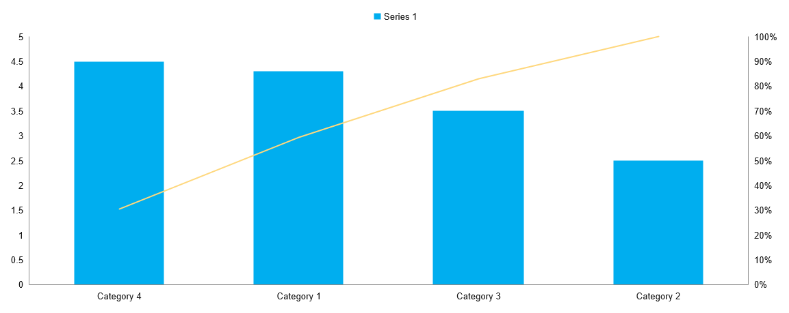
Your Slide Title Here
Your Slide Subtitle
Indent one for body copy style

Slide 16

Your Slide Title Here
Column 1 | Column 2 | Column 3 | Column 4
Row 1 | Text

Slide 17


Slide 18


